Slide 1

AI-Based Chatbot for Groundwater Information
Collation and Dissemination of Groundwater Data
Presented by: Rohit
Institution: Bennett University
Course - AIML
RR
by Rohit Raj

Slide 2

The Groundwater Challenge
Vital Resource
Growing Scarcity
Groundwater supplies about 40% of global drinking water.
Demand rise and climate change worsen availability.
Data Fragments
User Needs
Information is scattered and hard to access effectively.
Calls for efficient and friendly data access solutions.

Slide 3
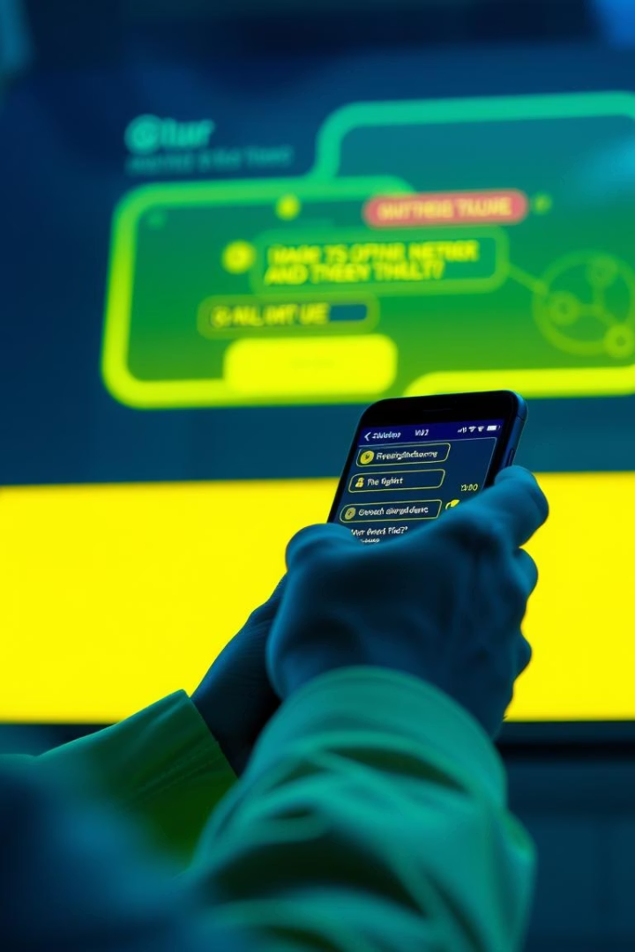
Introducing the AI Chatbot Solution
Centralized Platform
AI Interface
Chatbot powered with natural language processing.
Aggregates groundwater data in one user-friendly hub.
Instant Support
Available 24/7 for quick, easy queries.

Slide 4
Chatbot Features & Functionality
Data Sources
Predictive Analysis
USGS and state agencies
Trend forecasting
Research papers
Contamination risk alerts
Real-Time Data
Additional Features
Water levels and quality
Multilingual support
Usage and recharge stats
Visual and interactive maps

Slide 5
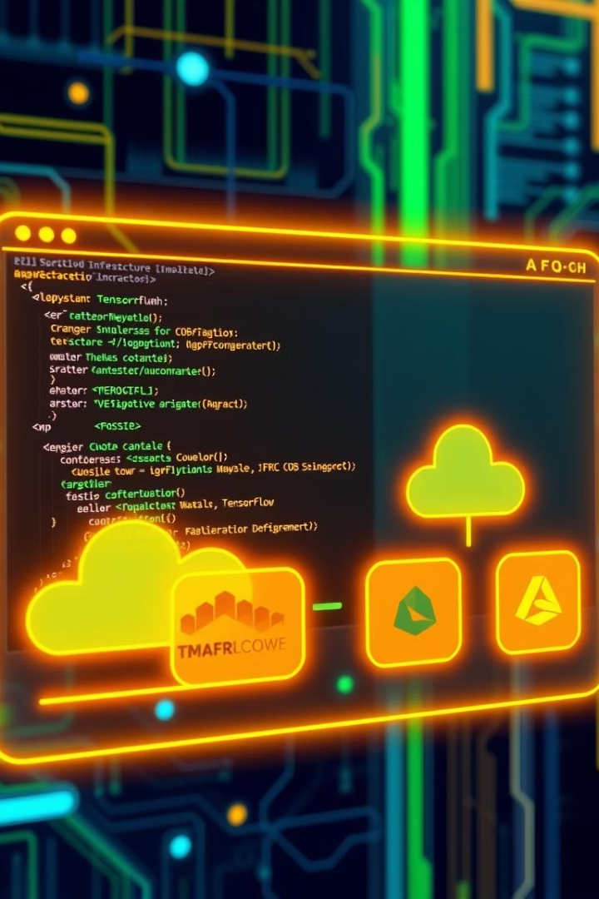




Technology Stack
AI & ML
NLP Tools
Database
TensorFlow, Python for intelligent data processing
spaCy and NLTK for natural language understanding
PostgreSQL with PostGIS for spatial data management
Cloud
AWS and Azure platforms for scalable deployment
API integrations bring diverse data into a unified system.

Slide 6

Development & Training
1
Data Pipeline
Established data collection and cleaning mechanisms
2
Training Data
Over 10,000 question-answer pairs prepared
3
Continuous Learning
AI improves from ongoing user interactions
4
Accuracy
Initial testing shows 92% accuracy rate

Slide 7
Impact & Benefits
Better Access
Cost Effective
Easy reach to critical groundwater data
Affordable, scalable solution for multiple regions
Informed Decisions
Wide Adoption
Supports farmers and policymakers effectively
Designed to expand across diverse areas

Slide 8

Future Directions
IoT Integration
Real-time groundwater monitoring with sensors
Expanded Data
Include other environmental datasets
Strategic Partnerships
Collaborate with governments and research bodies
Engagement
Open floor for questions and feedback

